Slide 1


Vocational Technical (VoTech) Program
OVERALL CLASSIFICATION OF THIS BRIEFING IS
UNCLASSIFIED/FOR OFFICIAL USE ONLY

Slide 2
358th CA BDE VoTech Team
(DSN 835-2116)
Colonel Ronald Allen
Lieutenant Colonel Jorge Milla
Captain Antonio Ward
SSG Eric Ritchey
Dr. Sarchel Jaff, BBA
Mr. Omar Abood, BBA

Slide 3


Importance of VoTech Training
Vocational technical (VoTech) training is vital to the development of any nation’s workforce
--Provide a pool of skilled laborers
    --Operate and repair modern systems and equipment
    --Serve as the skilled tradesmen essential to everyday life
  VoTechs are critical to growing an economy and maintaining a high standard of living
Notes:
Vocational training is critical to the development of any nation’s workforce. VoTechs provide the pool of technologically skilled laborers needed to operate and repair modern systems and equipment, ranging from farm machinery to IT networks, and serve as the skilled tradesmen (carpenters, plumbers, electricians) essential to everyday life. Deprived of this skill base, a nation’s civil and economic foundation would begin to fail, making growth extremely difficult. Systems would be idled, utilities would operate sporadically, communications and distribution networks would disintegrate, foreign investors would depart, and standards of living would decrease.

Slide 4
Current Problem
Iraq has an acute shortage of skilled laborers
  During the 10 years prior to OIF, few people received an up-to-date VoTech education
  Following combat operations in 2003, most of the Ministry of Labor and Social Affairs (MoLSA) 23 VoTechs were damaged and/or looted
Iraq has a wealth of youth looking for a way to make a living
  60% of the Iraqi population is 30 years of age or less
  Stuck in low-income -- cannot advance due to being under-trained/under-educated
Combined, this is leading to:
  An economy which cannot grow, will not attract foreign investment
  Lower standards of living and a lack of hope
  A larger recruiting pool for militias and anti-GoI forces
Notes:
Exacerbated by years of neglect and mismanagement. MOLSA's vocational training program had weakened over the years preceding OIF, and few Iraqis received an up-to-date vocational education. The Ministry's compound on Palestine Street in Baghdad was commandeered by the Ministry of Military Industries. Instead of computer-skills training for the unemployed, Hussein's military machine taught chemical engineering. In place of air-conditioner repair instruction, the compound produced or assembled Rocket Propelled Grenade (RPG) cylinders. Rather than housing auto repair equipment, the center stored Scud missile nosecones. By the spring of 2003, the MOLSA was in shambles. Decades of Ba'athist oppression, an economy severely crippled by 8 years of the Iran-Iraq War (1980-88), the devastation of the Persian Gulf War in 1991, and 12 years of subsequent U.N. sanctions had brought the Ministry to its knees.
To make matters worse, following combat operations in 2003, many VoTechs were damaged; as a rule, even those that were structurally intact lost their equipment to looting. So, even those lucky enough to gain entry into a VoTech usually found themselves working with damaged and/or obsolete equipment. Iraqi national reconstruction and economic recovery require a host of skilled laborers, yet very few are being trained. In 2005 MoLSA’s twenty-three VoTech sites graduated only 3,700 students.
There are approximately 7 million (M) Iraqis between the ages of 15 and 30, of which 3.6M of these are males. Under the previous regime, these Iraqis received minimal education. Many of these citizens have little in the way of a future. The resulting disaffection and marginalization could result in large numbers remaining in or joining militias or anti-GoI groups, compounding existing problems throughout Iraq. Additionally, the lack of a trained skilled force will inhibit civil and economic development, resulting in a continued downtrend in standards of living, and millions of dollars in GDP loss.

Slide 5
Supported Subject Areas
Welding
Electrical Installation
Cosmetology
Construction Carpentry
Generator Repair
Furniture Carpentry
Plumbing
Masonry/Tiling
Metal Working
Computer Repair
Basic Computer operation
Auto Mechanics/Electrical Systems
Commercial Baking
Farm Machinery Repair
Turnery & Lathing
Sewing/Tailoring
Air Conditioning and Refrigerator repair
Painting/Plastering
Notes:
This is the list of standard subjects that will be supported. The final list for each will be developed following the NGO site surveys, which will further evaluate area job market requirements and ensure that the site is physically suited to the subject instruction. Course MUST have a full, approved curriculum in order to receive CF funding. A couple of these subjects do not yet have full curriculum. Additional subjects could be considered on a case-by-case, site-by-site basis.

Slide 6
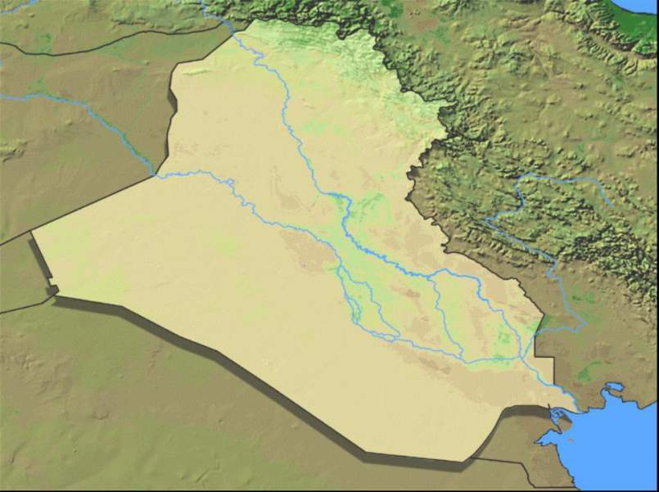
UNCLASSIFIED
UNCLASSIFIED/FOUO
Irbil
Mosul
Kirkuk
SYRIA
IRAN
Baghdad
JORDAN
Iskanderiyah
Al Kout
Najaf
SAUDI ARABIA
Nasiriyah
Alkaseeb
Al Basrah
Al Zoubair
KUWAIT
KUWAIT
Kuwait City
MoLSA Sites
UNCLASSIFIED
Notes:
The next series of slides illustrate the location of existing and potential MoLSA VoTech sites across Iraq, and how they fit into the program.
This map depicts the four sites (blue stars) where C9 is providing facilities rehabilitation and equipment, which are also priority CSP sites. These facilities are being operationalized by USAID. Kirkuk and Mosul will be conducting classes before the end of April. The Basra sites have more significant facilities requirements and require follow-on engineering assessments. There is no estimated date for classes to begin, but it will probably not be before early June.

Slide 7
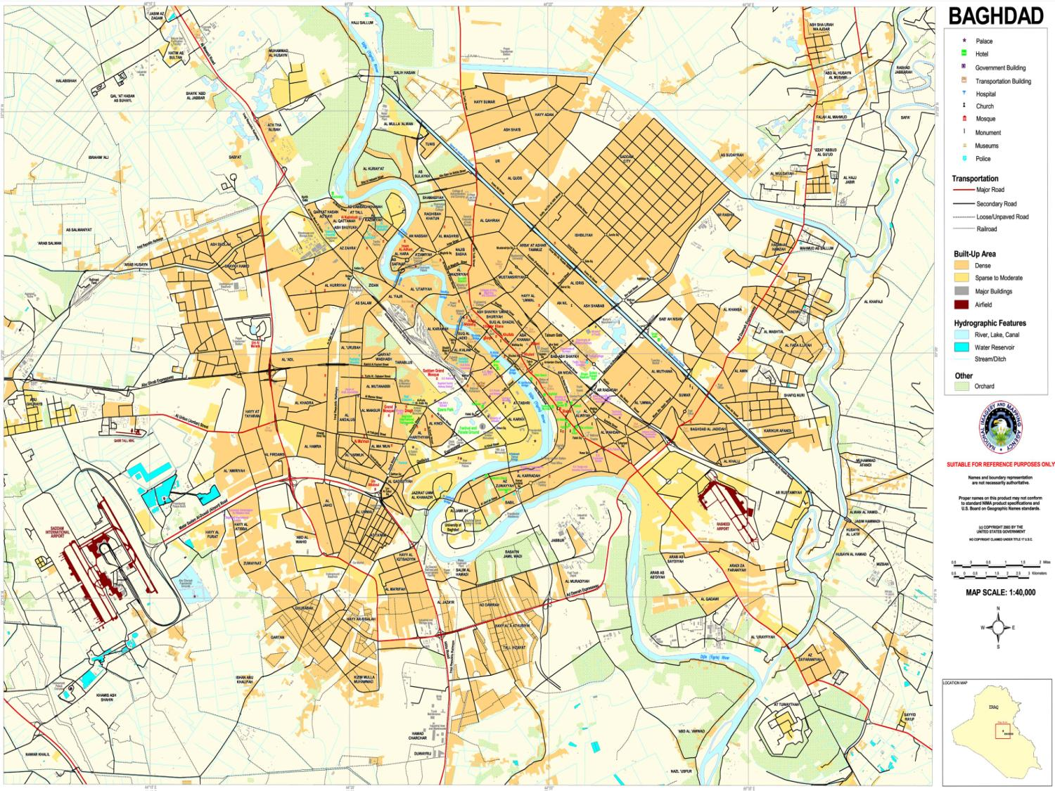
UNCLASSIFIED/FOUO
Al Shab
Hay Ur
Al Sader
Al Rashad
Al Shu’lah
Al Waziria
Al Muaatassime
Abou Ghreb 2
Abou Ghreb 1
Walid
Zafarania
MoLSA Baghdad Sites
Notes:
This map illustrates the Baghdad VoTech sites. The three sites shown in purple have been operational since 4Q06, and have trained over 1700 students to date.

Slide 8
UNCLASSIFIED
UNCLASSIFIED/FOUO
Tal Afar
Sulaimanyah
SYRIA
Al Qaim
Ramadi
IRAN
Fallujah
JORDAN
SAUDI ARABIA
KUWAIT
KUWAIT
Kuwait City
New Sites
UNCLASSIFIED
Notes:
This map depicts the two sites (green stars) where C9 is providing facilities rehabilitation and equipment, which are also CSP sites. However, they are lower priority areas, and USAID has not yet set a schedule for operations. These sites will be surveyed in March and, depending on their physical condition, could be ready for USAID or GoI-sponsored classes by late June or early July.

Slide 9
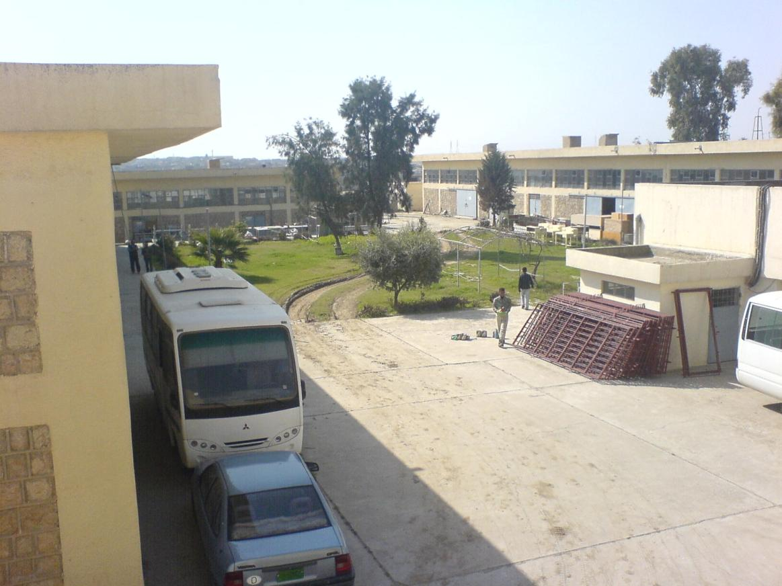
Mosul VoTech Center

Slide 10
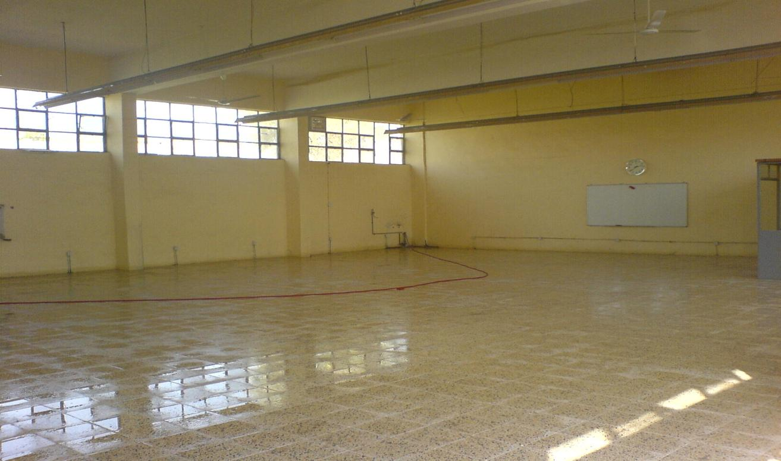
Mosul VoTech

Slide 11
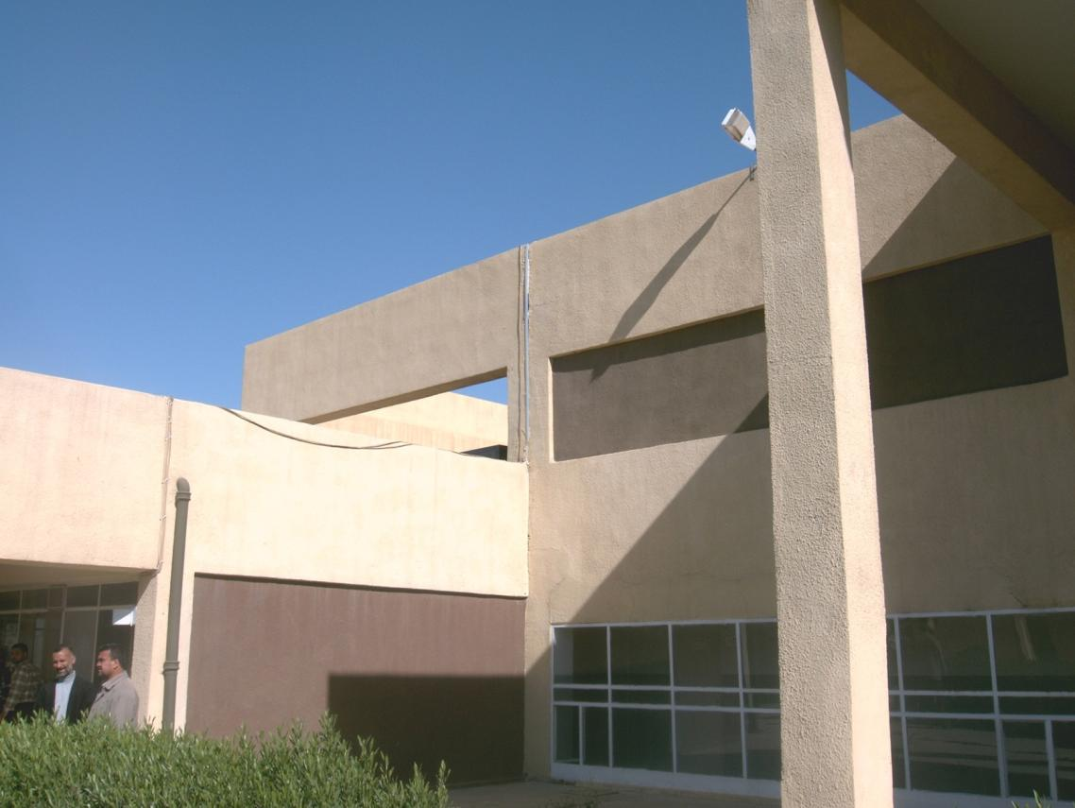
Kirkuk VoTech Center

Slide 12
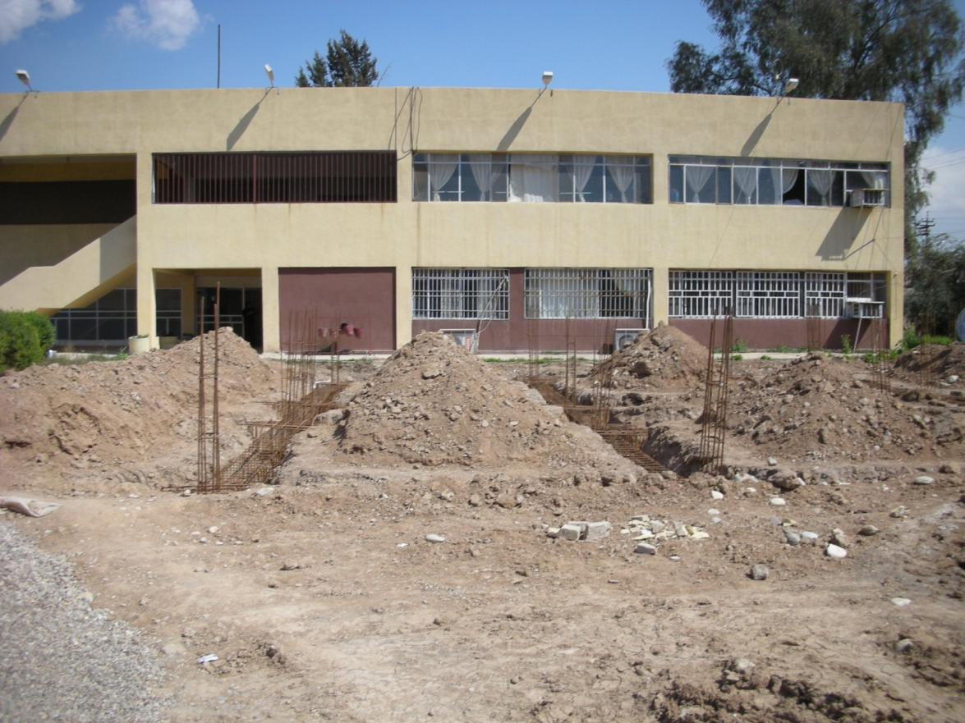
Kirkuk VoTech Center

Slide 13
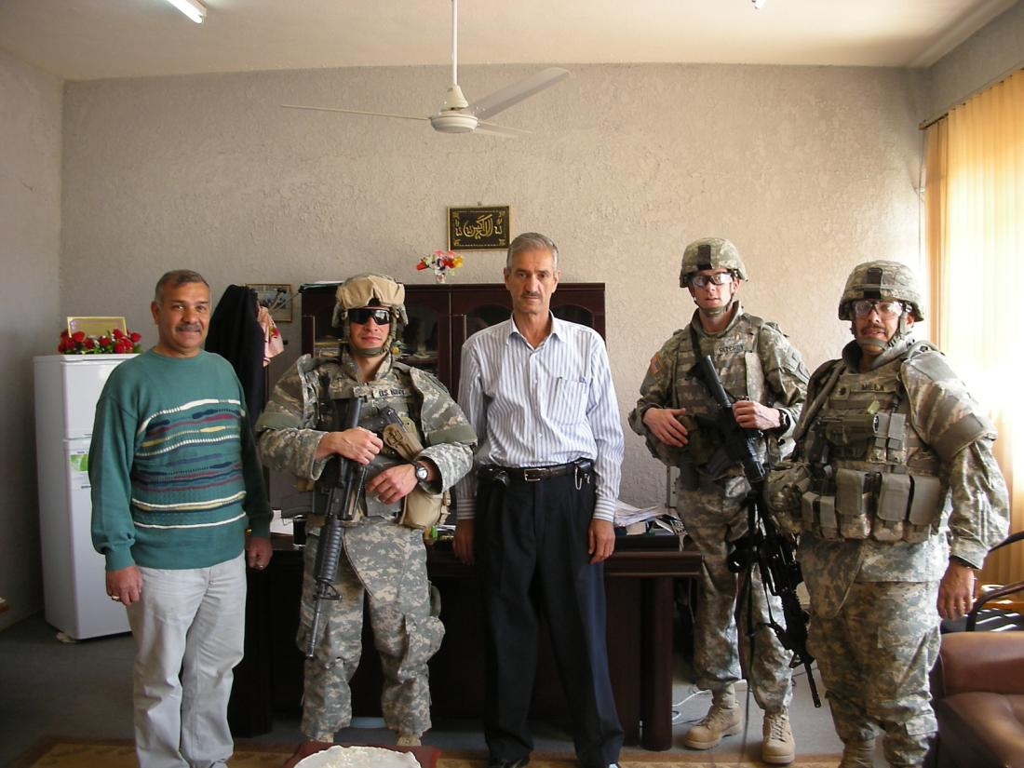
Kirkuk VoTech Center

Slide 14
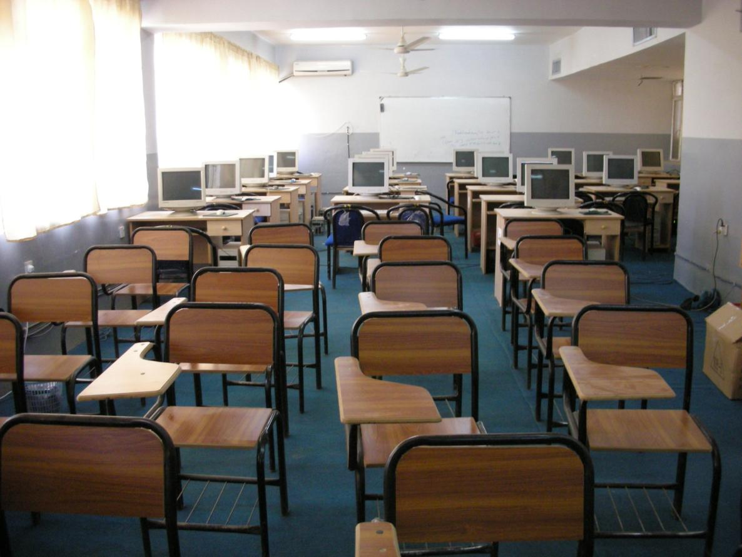
Kirkuk VoTech Center

Slide 15
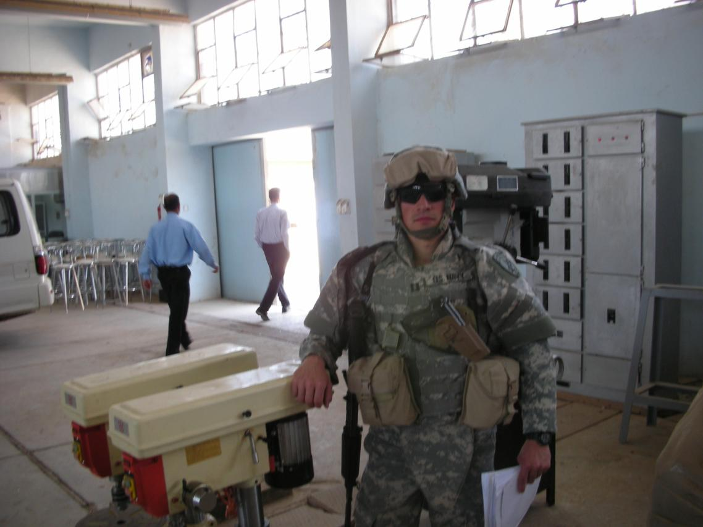
Kirkuk VoTech Center

Slide 16
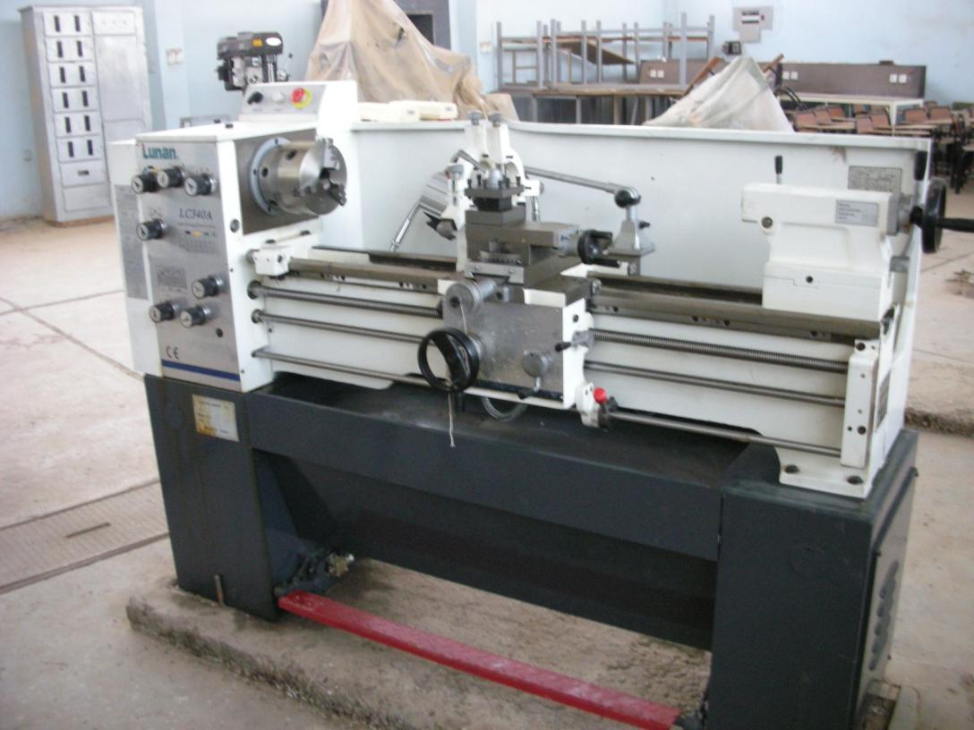
Kirkuk VoTech Center

Slide 17
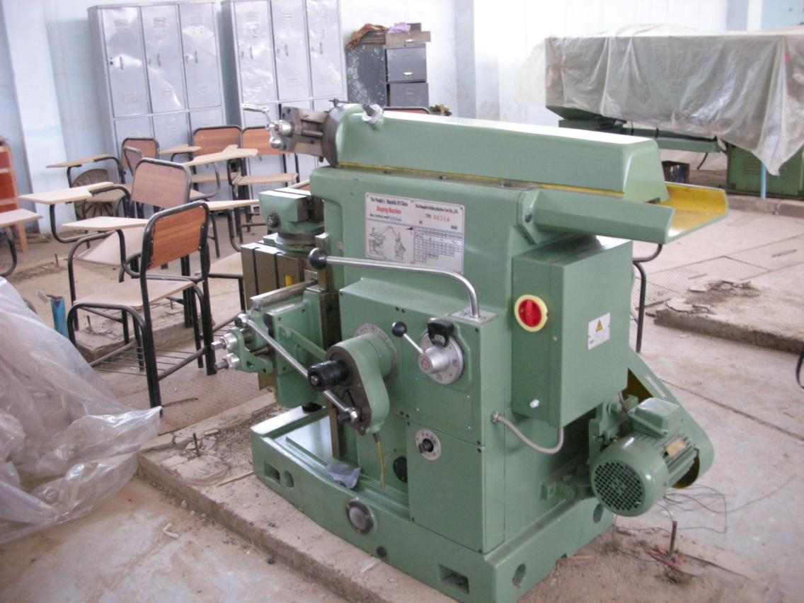
Kirkuk VoTech Center

Slide 18
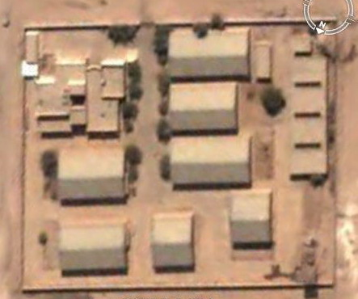
Najaf VoTech Center

Slide 19
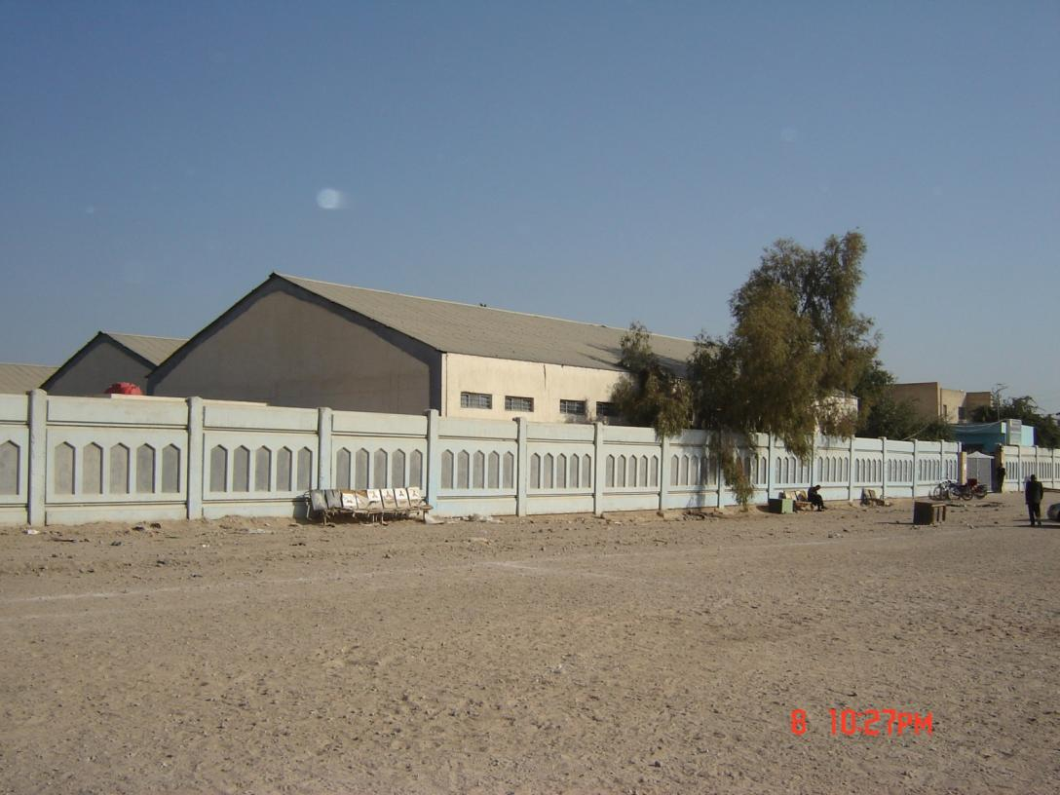
Najaf VoTech Center

Slide 20
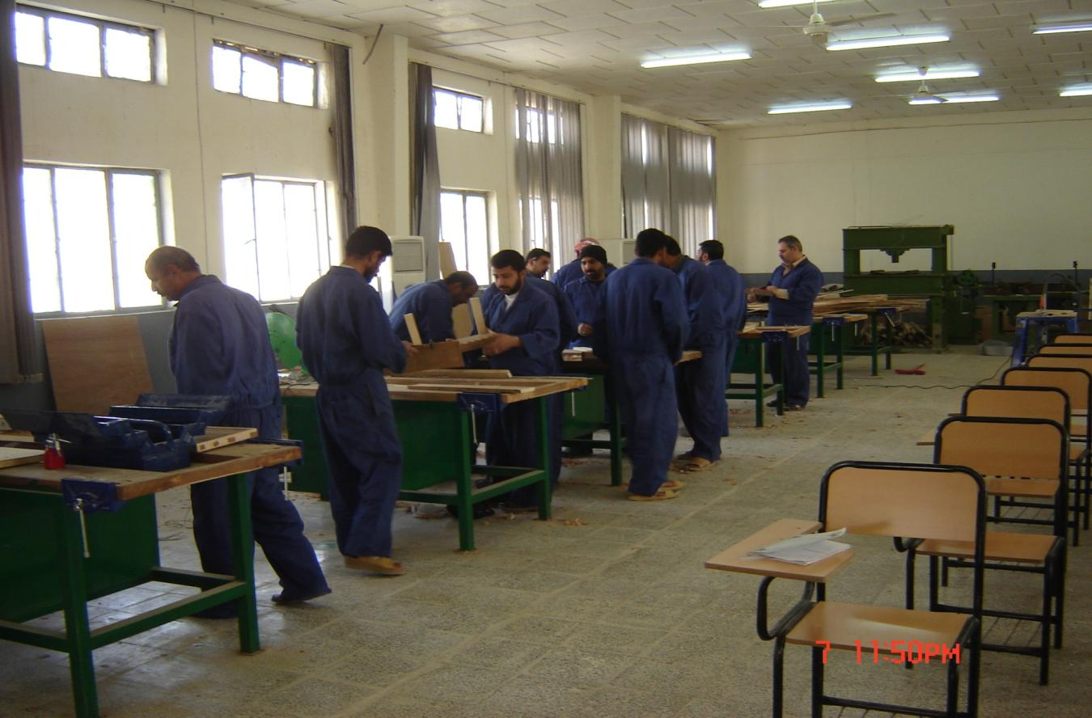
Najaf VoTech Center

Slide 21
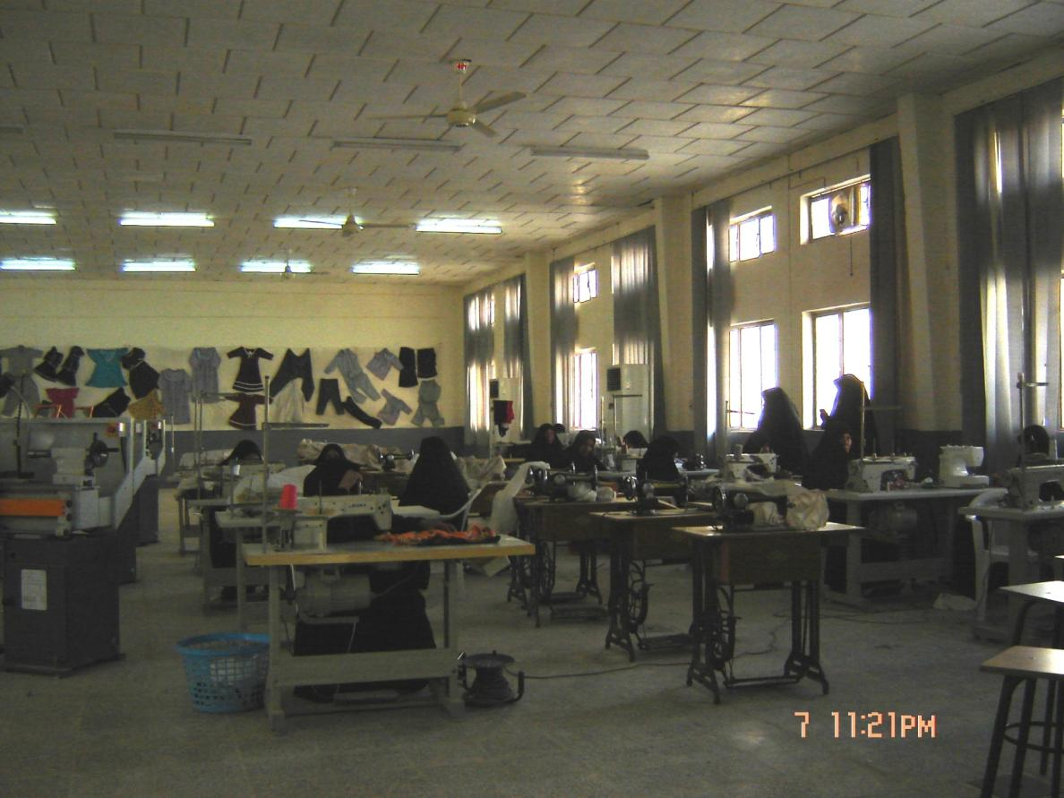
Najaf VoTech Center

Slide 22
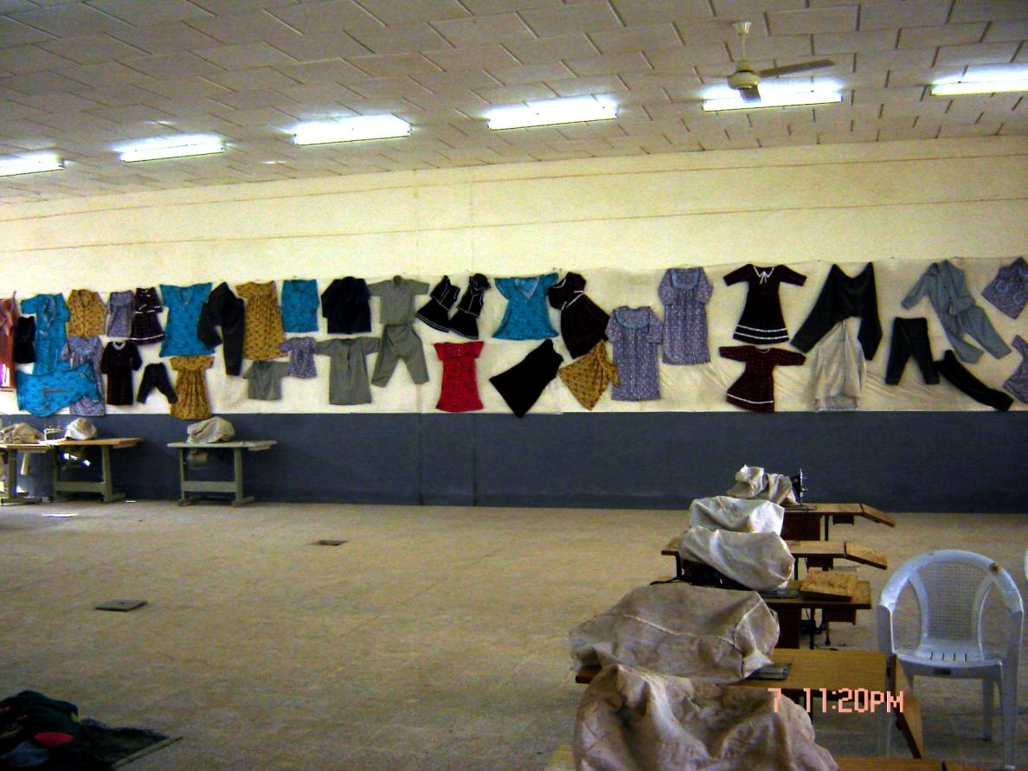
Najaf VoTech Center

Slide 23
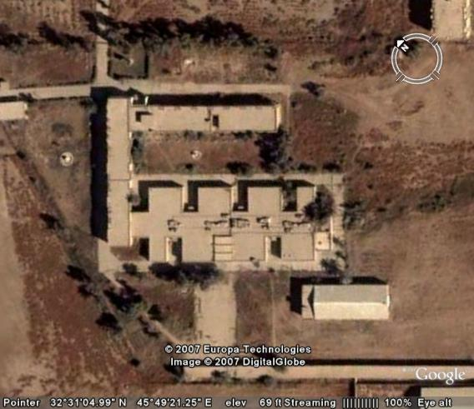
Kout VoTech Center

Slide 24
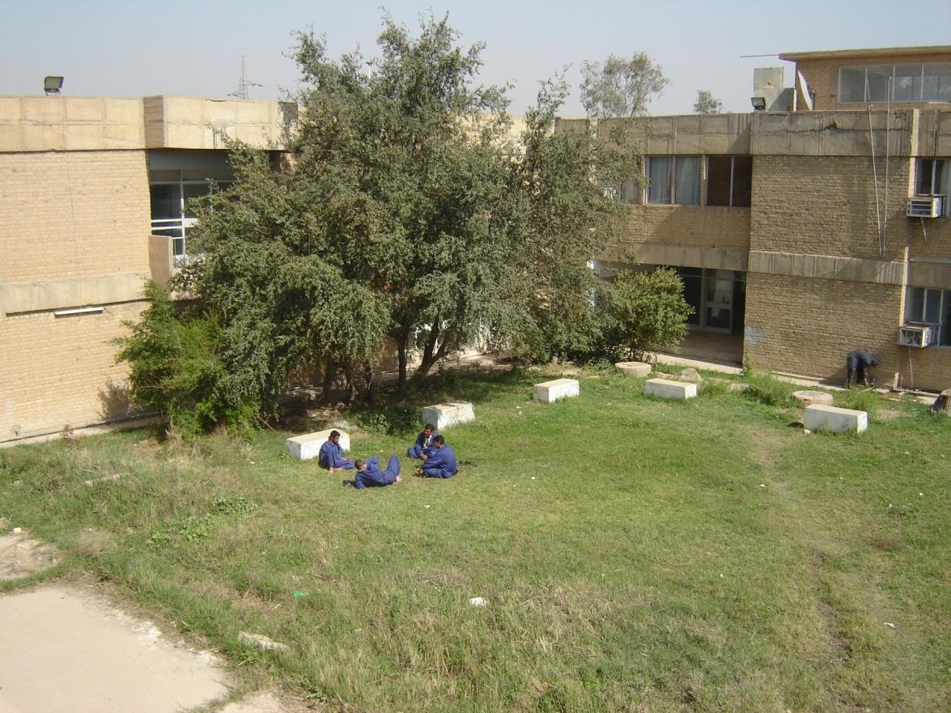
Kout VoTech Center

Slide 25
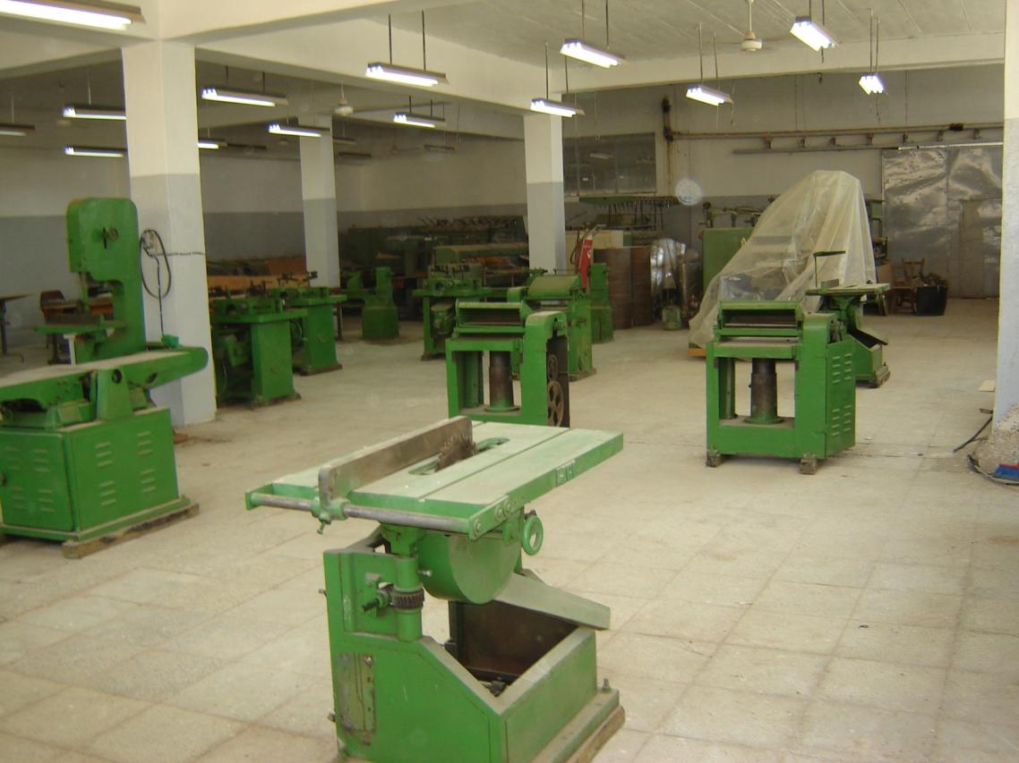
Kout VoTech Center

Slide 26
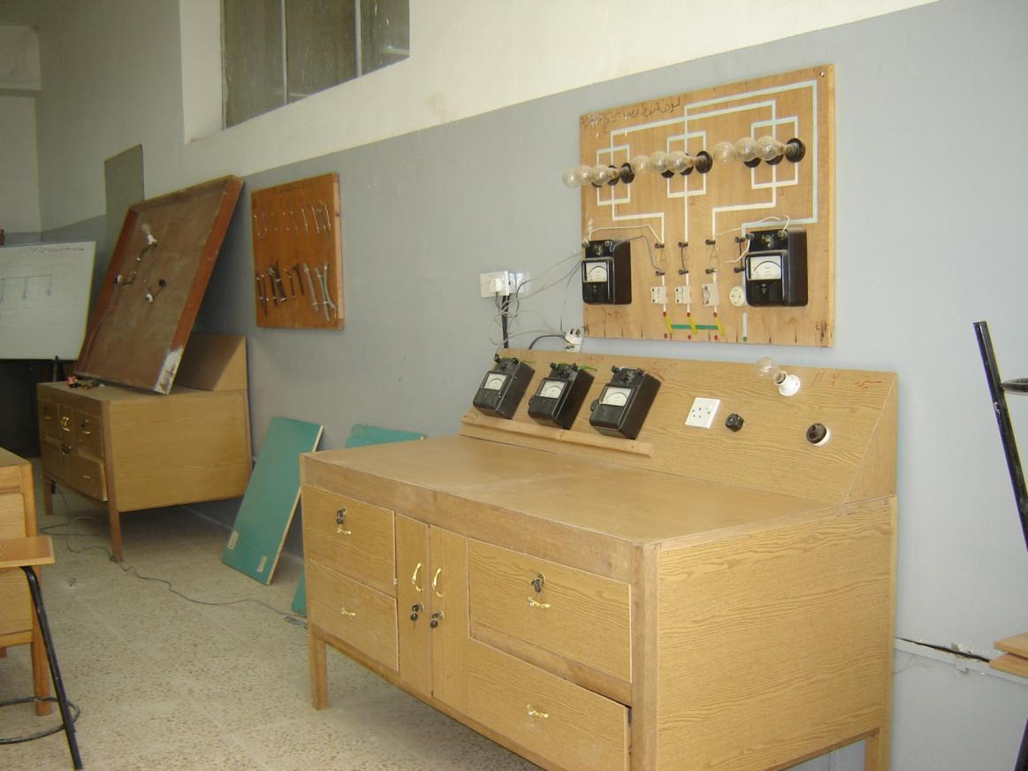
Kout VoTech Center

Slide 27
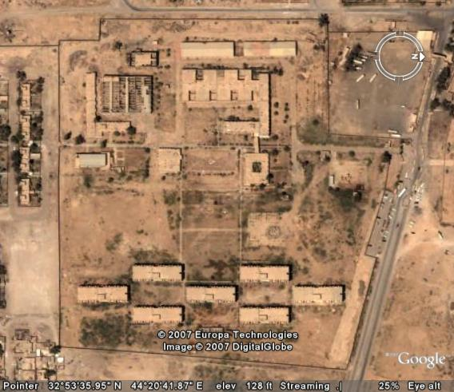
Iskanderiah VoTech Center

Slide 28
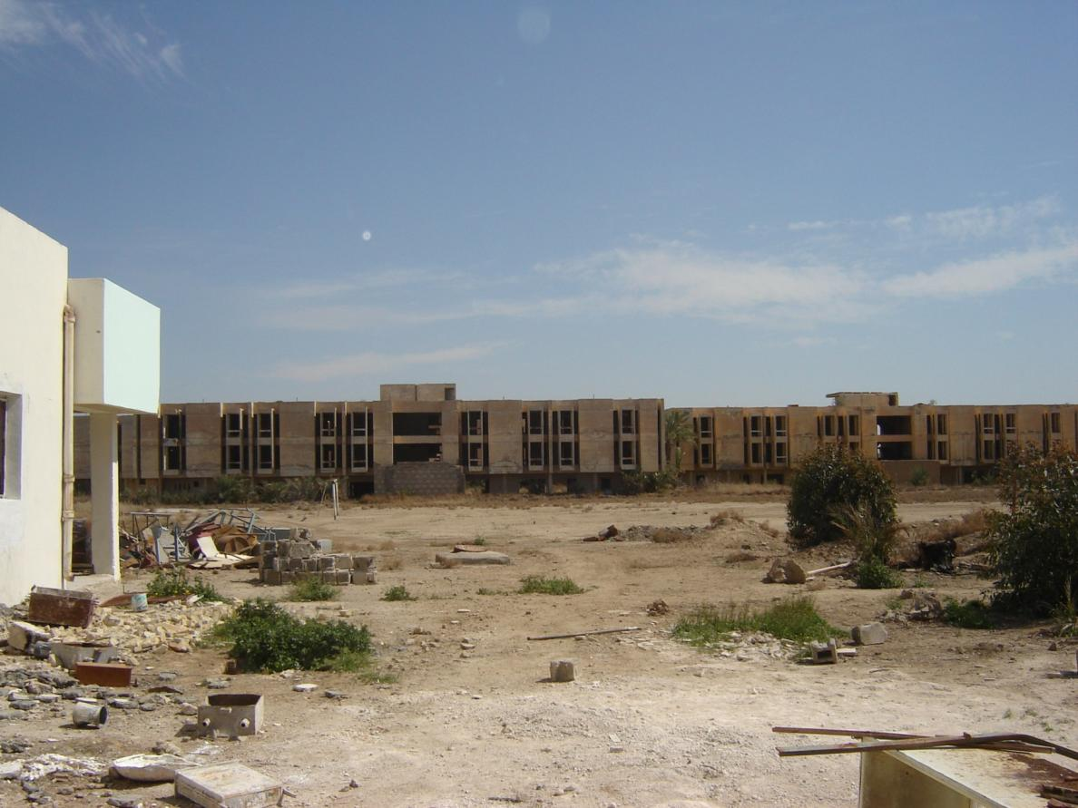
Iskanderiah VoTech Center

Slide 29
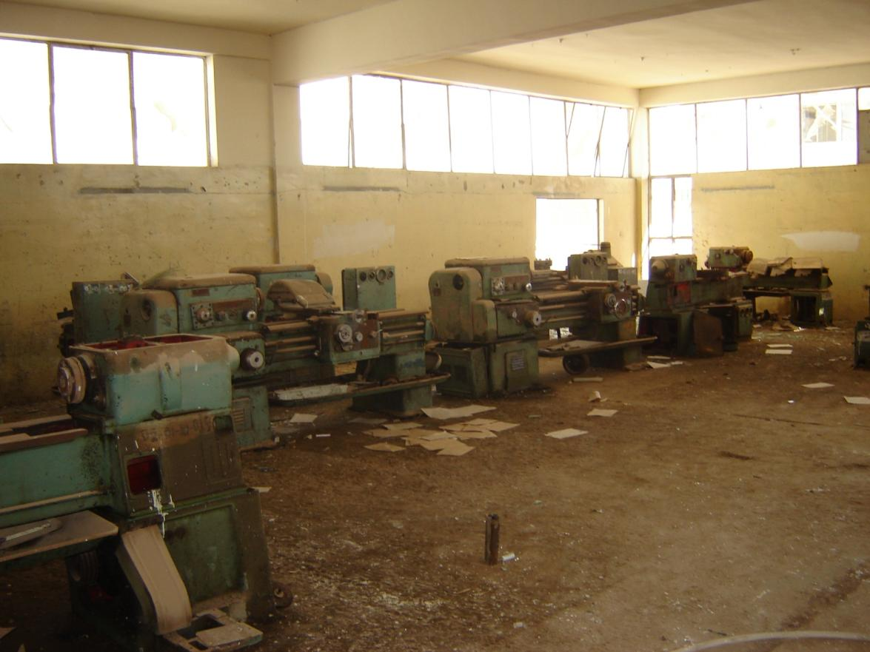
Iskanderiah VoTech Center

Slide 30
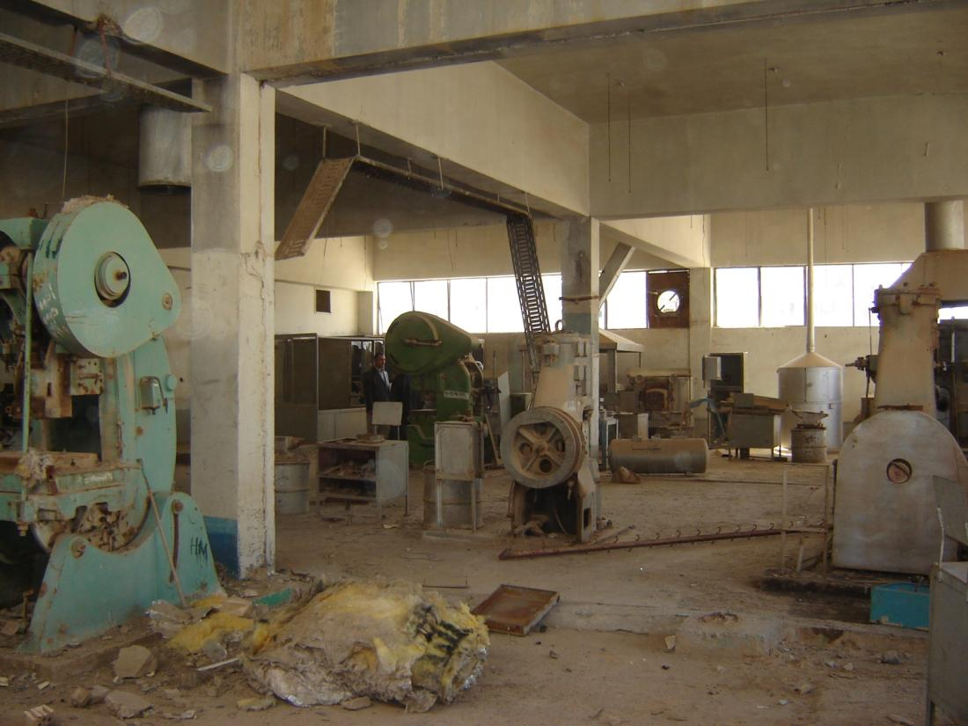
Iskanderiah VoTech Center

Slide 31
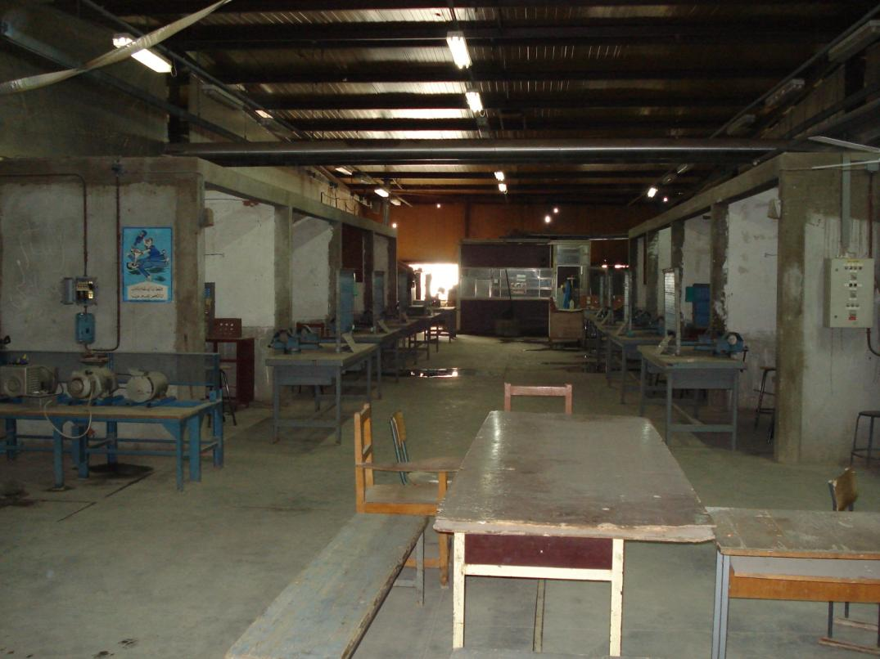
Khor Al-Zubair VoTech

Slide 32
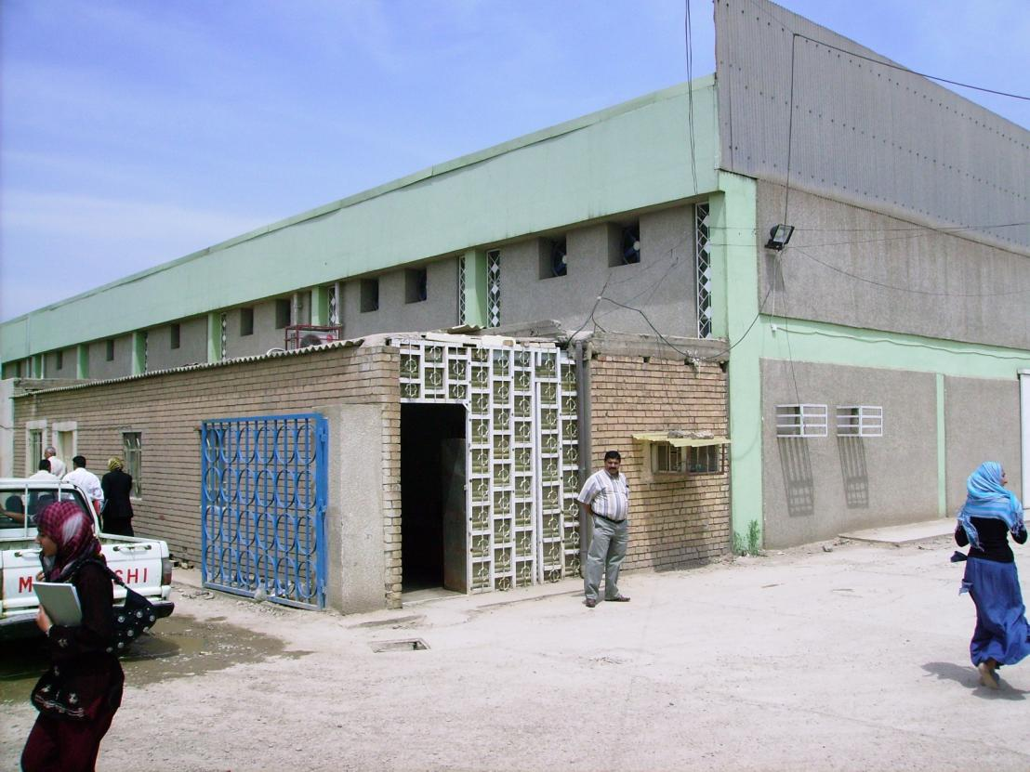
Al Waziryah VoTech School

Slide 33
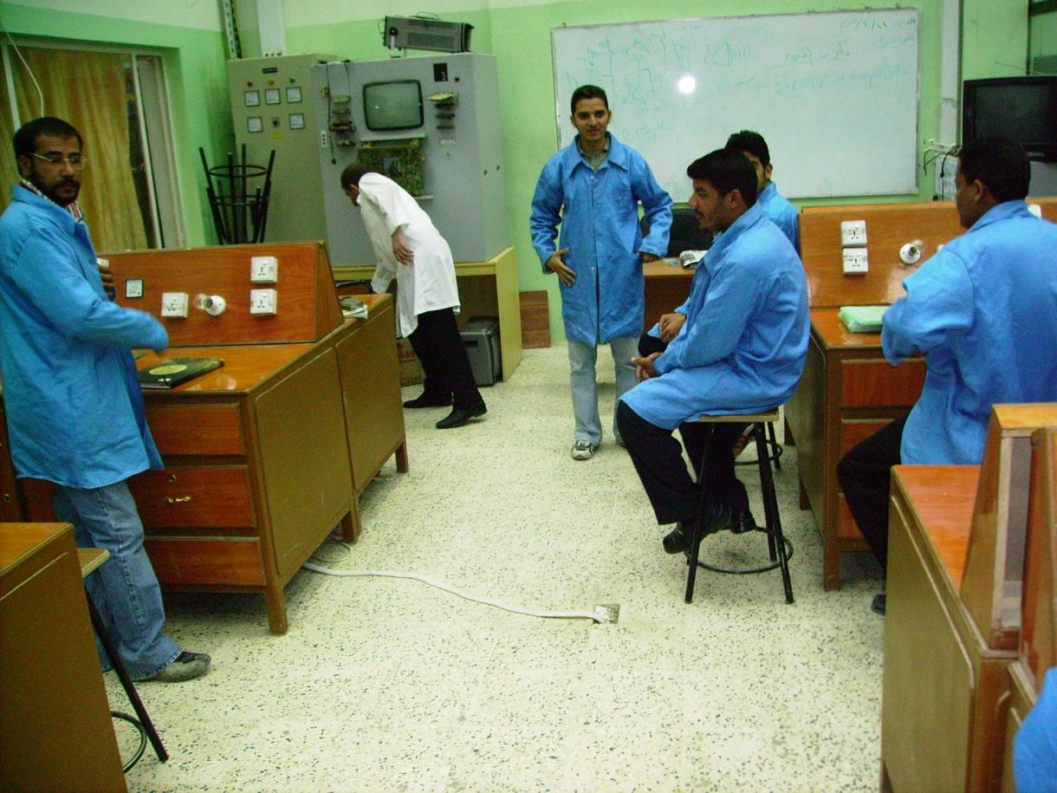
Al Wazinyah VoTech School

Slide 34
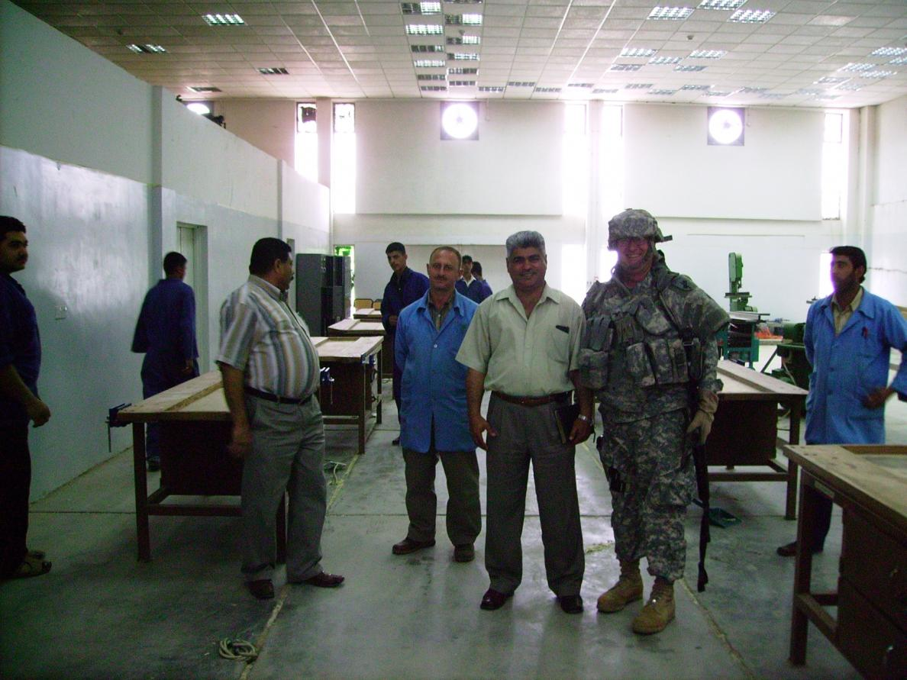
Waziryah VoTech Center

Slide 35
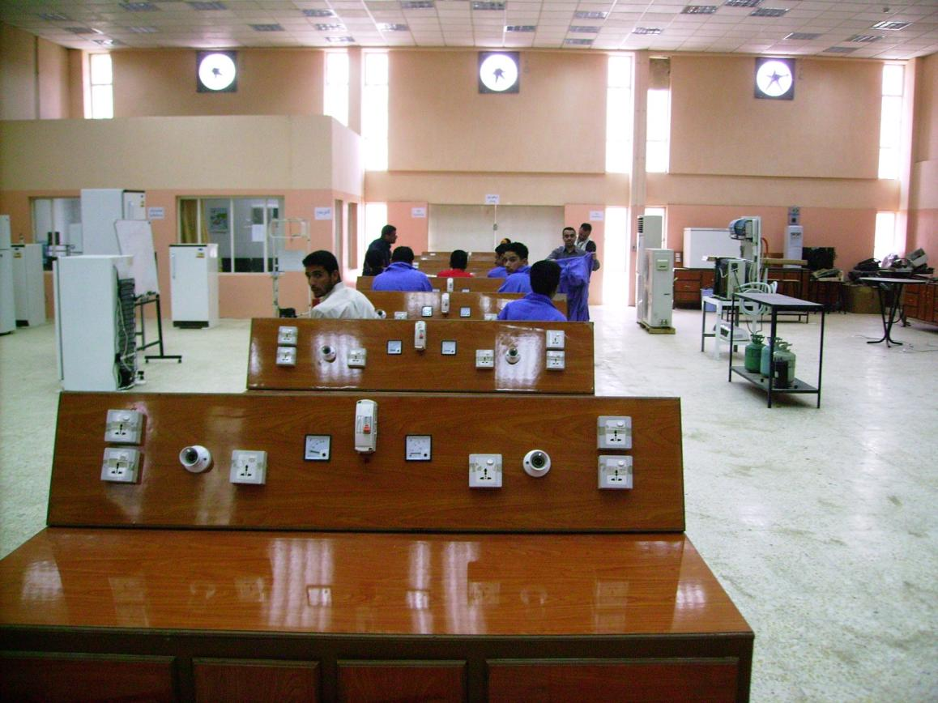
Waziryah VoTech Center

Slide 36
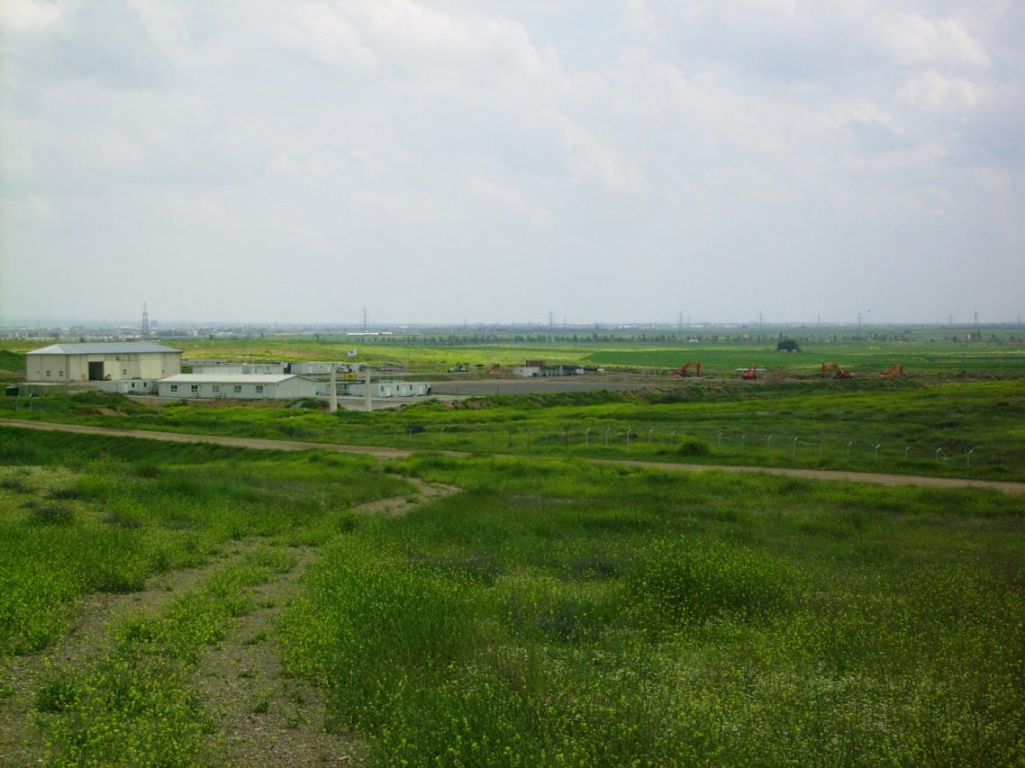
Arbil VTC

Slide 37
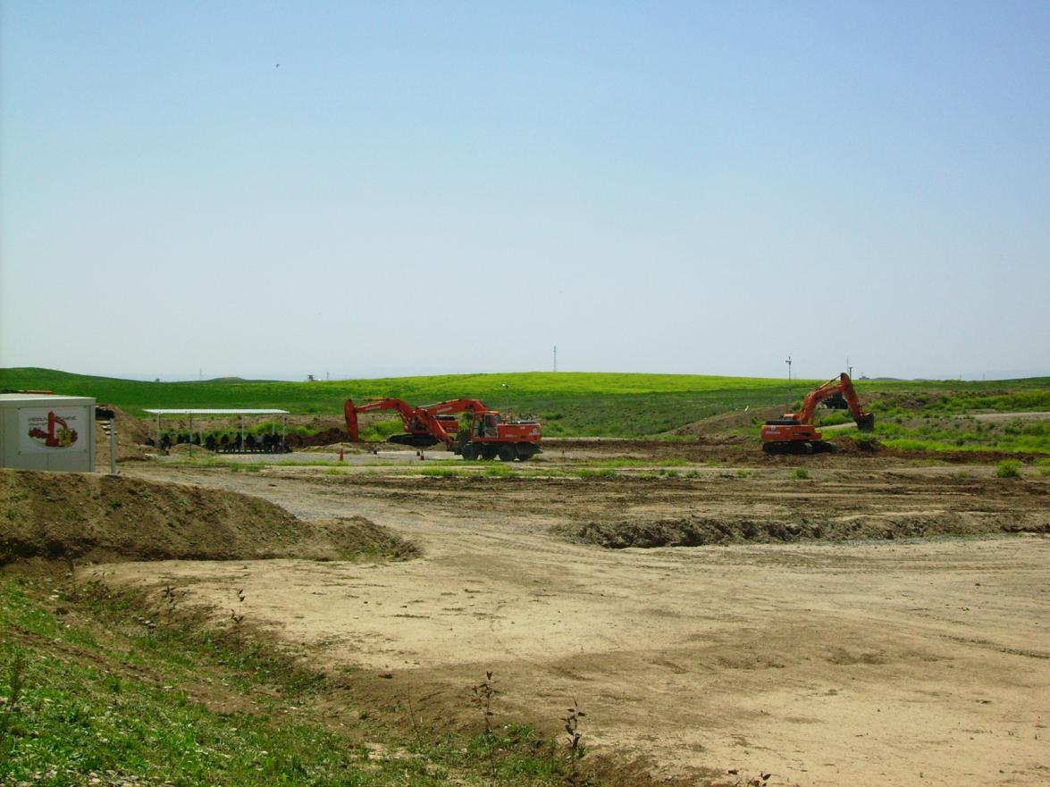
Arbil VTC

Slide 38
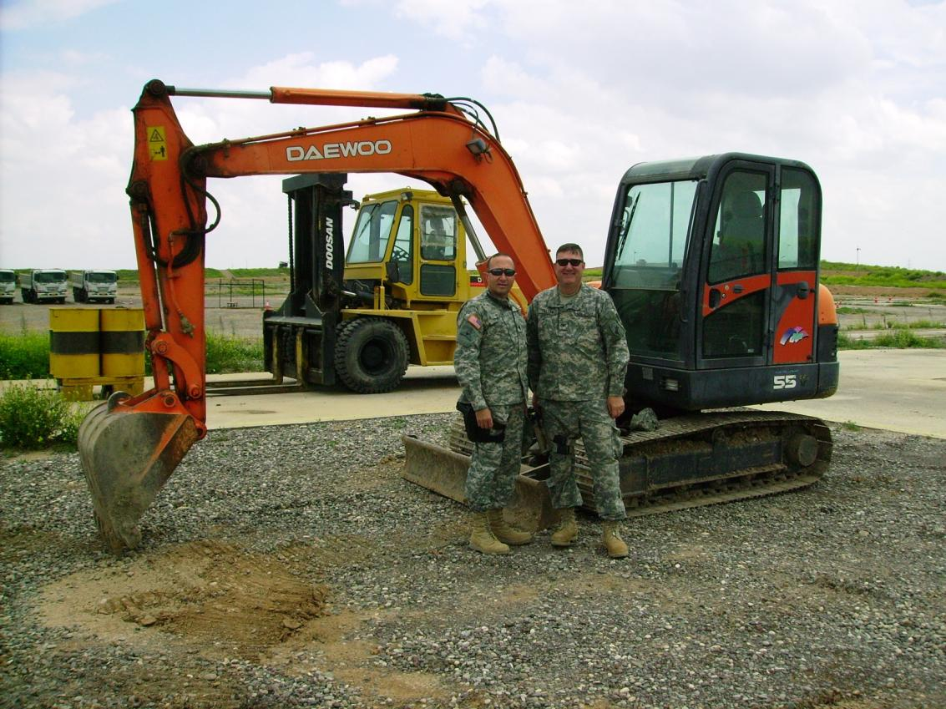
Arbil VTC

Slide 39
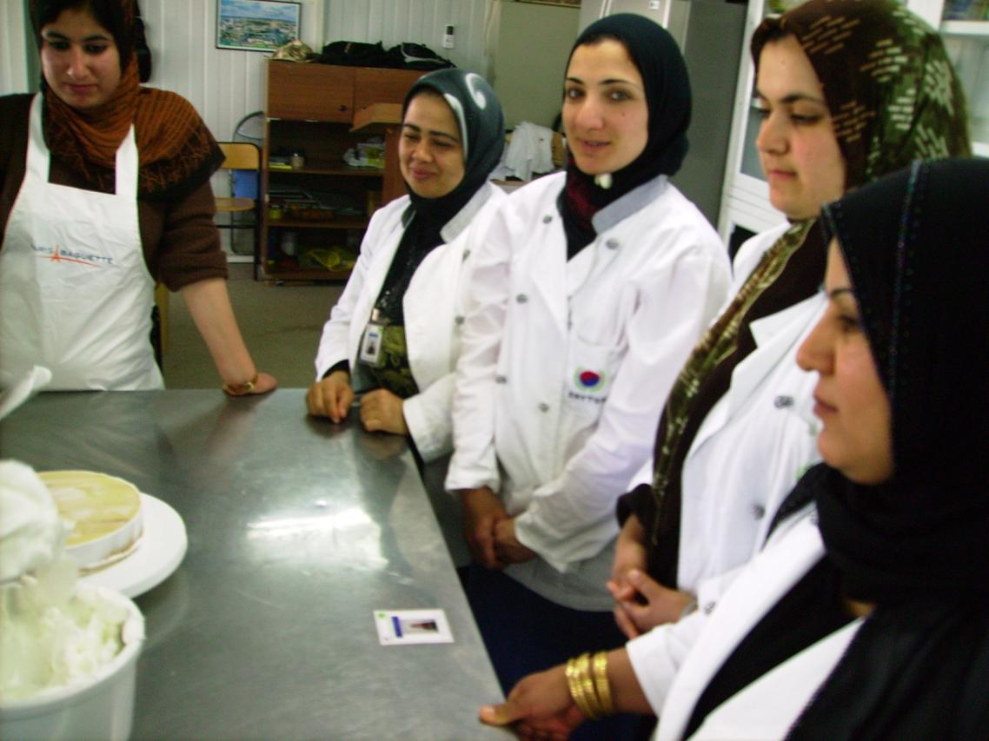
Arbil VTC

Slide 40
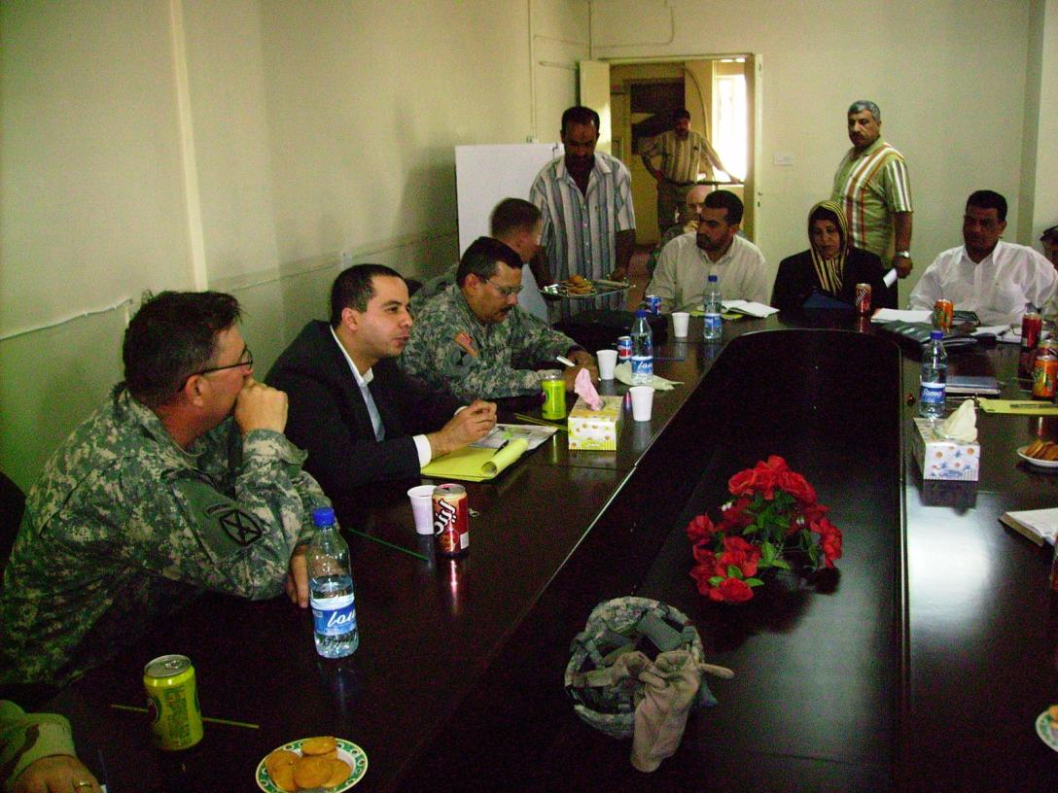
Meeting with Center Directors

Slide 41
Summary
  A skilled work force is critical to the Iraqi economy
  Training primarily military-aged males in order to provide an alternative to participation in insurgent or anti-GoI activities
  Iraqi Vocational Training Institutes (VoTechs) have been damaged and looted, or at best, are operating at a greatly reduced level with antiquated equipment.
  Without operational, modern VoTechs, the Iraqi infrastructure and economy will suffer from a lack of skilled laborers
  Assessments for all 23 sites have been completed
Notes:
As we mentioned in our opening remarks, vocational training is critical to the development of any nation’s workforce. Iraqi VoTechs are operating far below capacity, and are in urgent need of rehabilitation. Over the past 15 years, deprived of this skill base, the nation’s civil and economic foundation has begun to fail, making growth extremely difficult. Systems are being idled, utilities are operating sporadically, communications and distribution networks are disintegrating, foreign investors have departed, and standards of living have decreased.
C9 and USAID have combined to establish a sustainable, comprehensive program to begin solving this problem.

